Slide 1

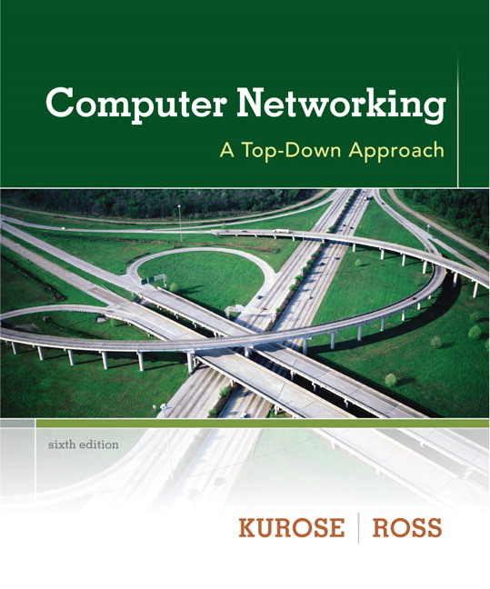
Chapter 6: Physical Layer & Network Devices
Computer Networking: A Top-Down Approach 6th edition Jim Kurose, Keith Ross Addison-Wesley

Slide 2
The Theoretical Basic for Data Communication
Fourier Analysis
Bandwidth-Limited Signals
Maximum Data Rate of a Channel
Notes:
là một biến đổi tích phândùng để khai triển một hàm số theo các hàm số sin cơ sở, có nghĩa là dưới dạng tổng hay một tích phân của các hàm số sin được nhân với các hằng số khác nhau (hay còn gọi là biên độ).

Slide 3
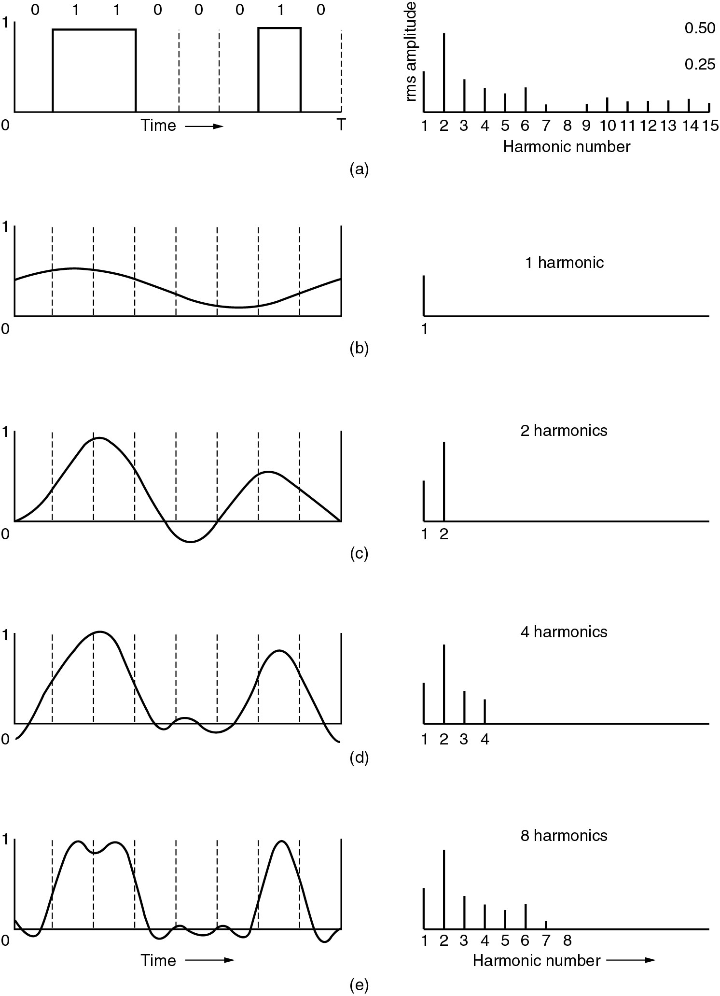
Bandwidth-Limited Signals
A binary signal and its root-mean-square Fourier amplitudes.
(b) – (c) Successive approximations to the original signal.

Slide 4

Bandwidth-Limited Signals (2)
(d) – (e) Successive approximations to the original signal.

Slide 5
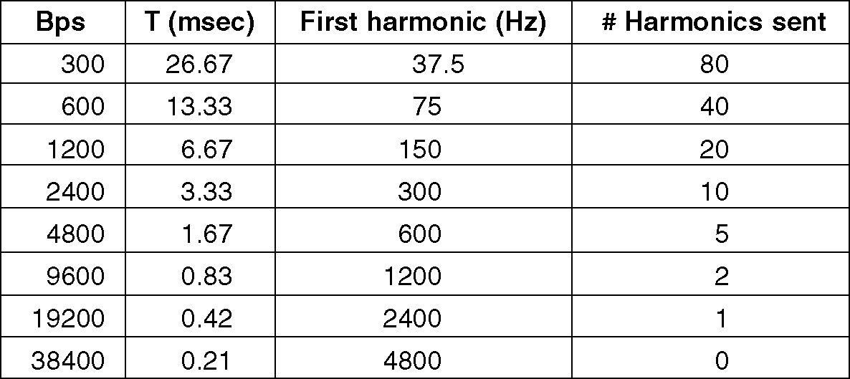
Bandwidth-Limited Signals (3)
Relation between data rate and harmonics.

Slide 6
Guided Transmission Data
Magnetic Media
Twisted Pair
Coaxial Cable
Fiber Optics

Slide 7
Twisted Pair
(a) Category 3 UTP.
(b) Category 5 UTP.

Slide 8
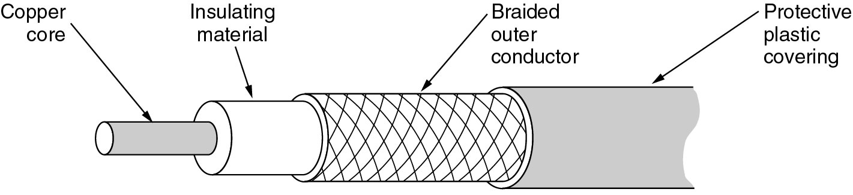
Coaxial Cable
A coaxial cable.

Slide 9
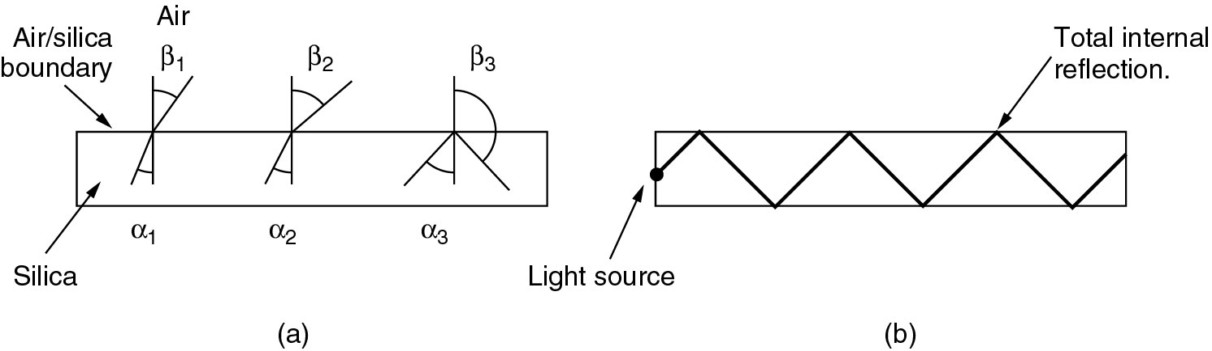
Fiber Optics
(a) Three examples of a light ray from inside a silica fiber impinging on the air/silica boundary at different angles.
(b) Light trapped by total internal reflection.

Slide 10
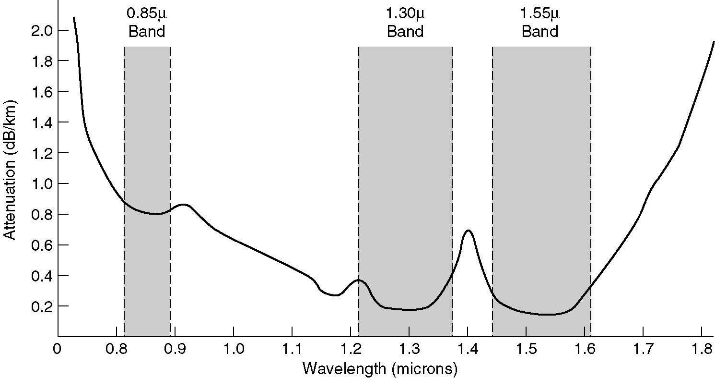
Transmission of Light through Fiber
Attenuation of light through fiber in the infrared region.

Slide 11
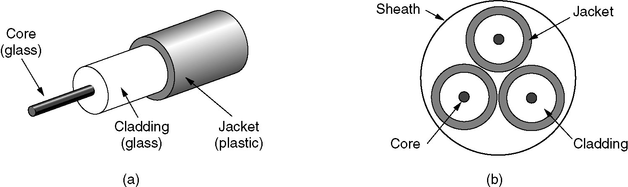
Fiber Cables
(a) Side view of a single fiber.
(b) End view of a sheath with three fibers.

Slide 12
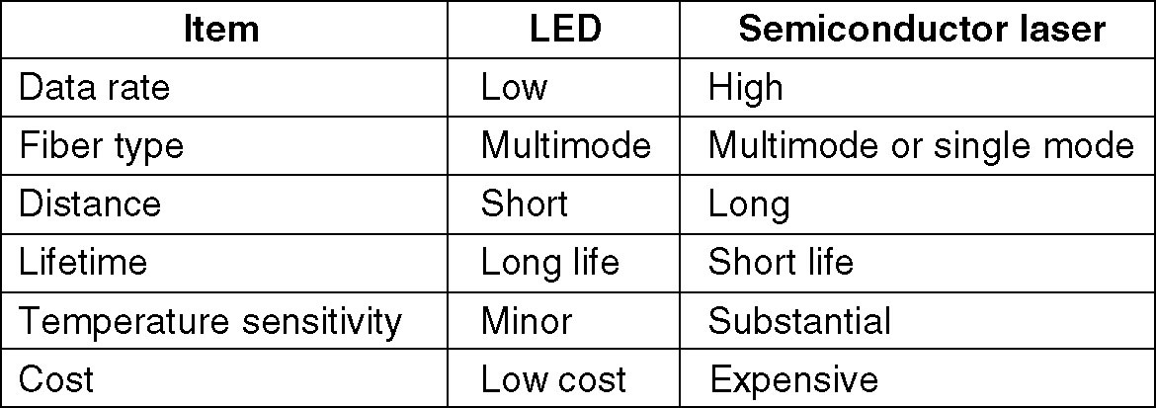
Fiber Cables (2)
A comparison of semiconductor diodes and LEDs as light sources.

Slide 13
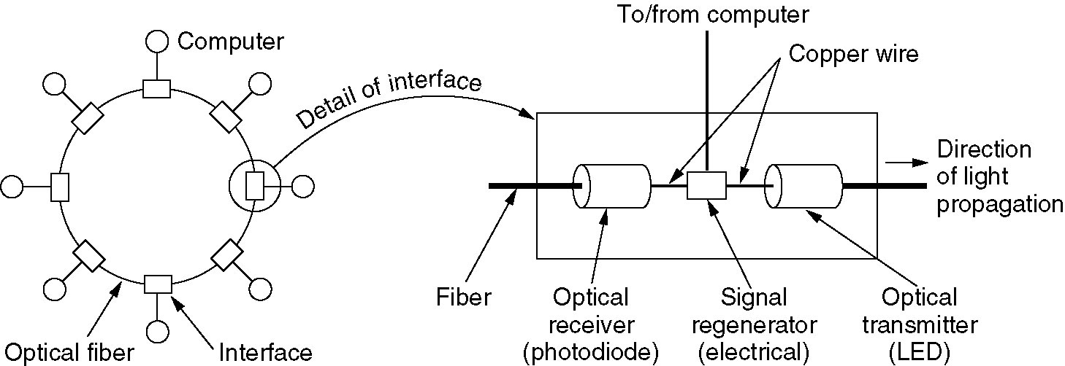
Fiber Optic Networks
A fiber optic ring with active repeaters.

Slide 14
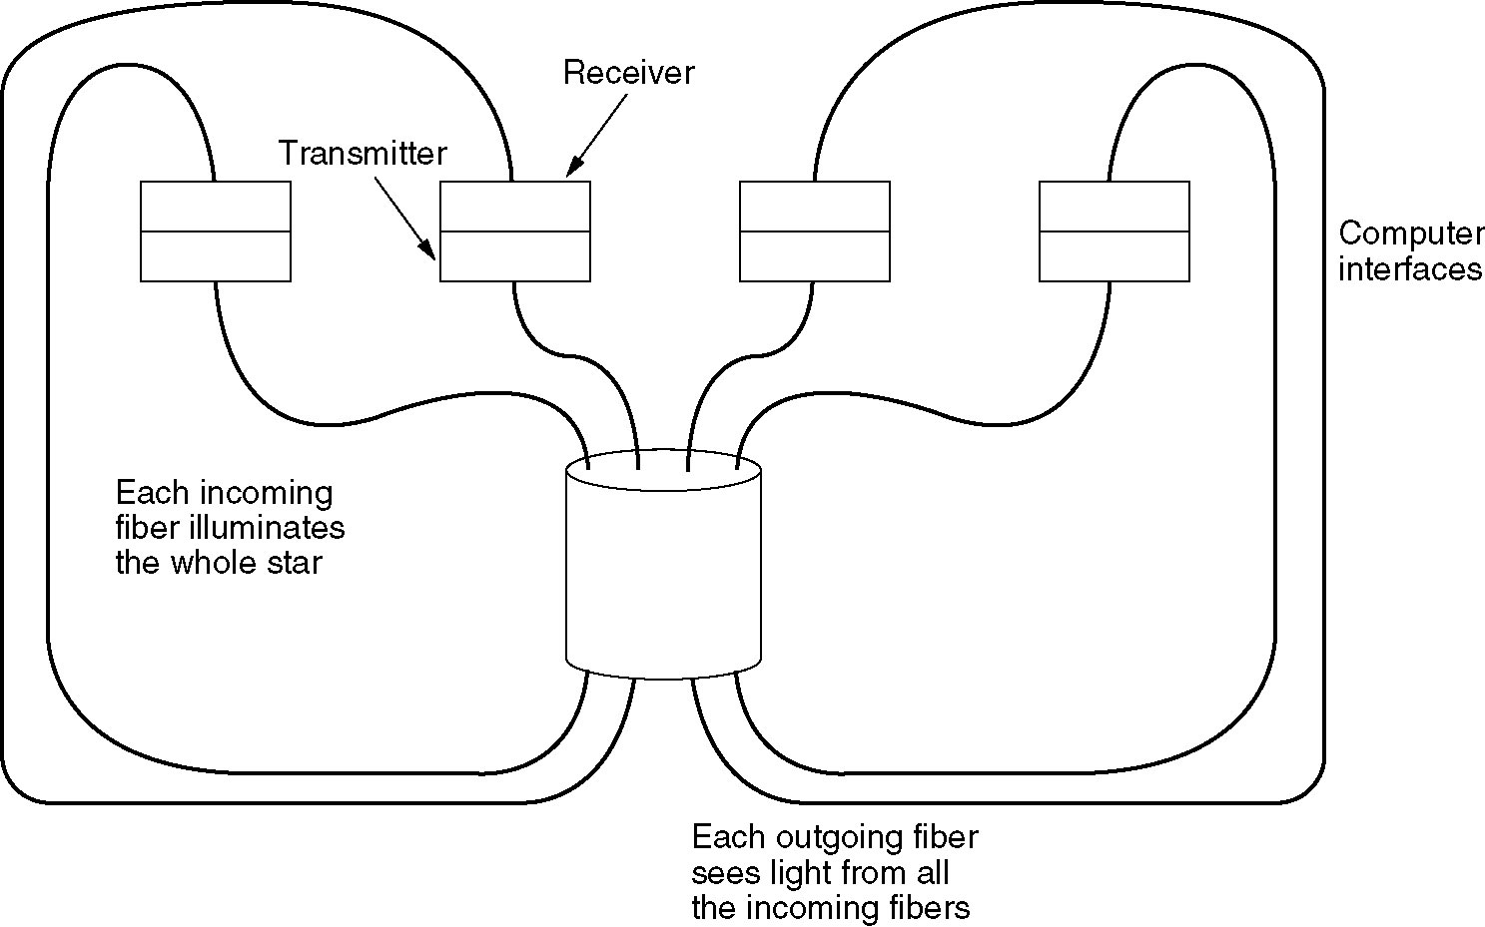
Fiber Optic Networks (2)
A passive star connection in a fiber optics network.

Slide 15
Wireless Transmission
The Electromagnetic Spectrum
Radio Transmission
Microwave Transmission
Infrared and Millimeter Waves
Lightwave Transmission

Slide 16
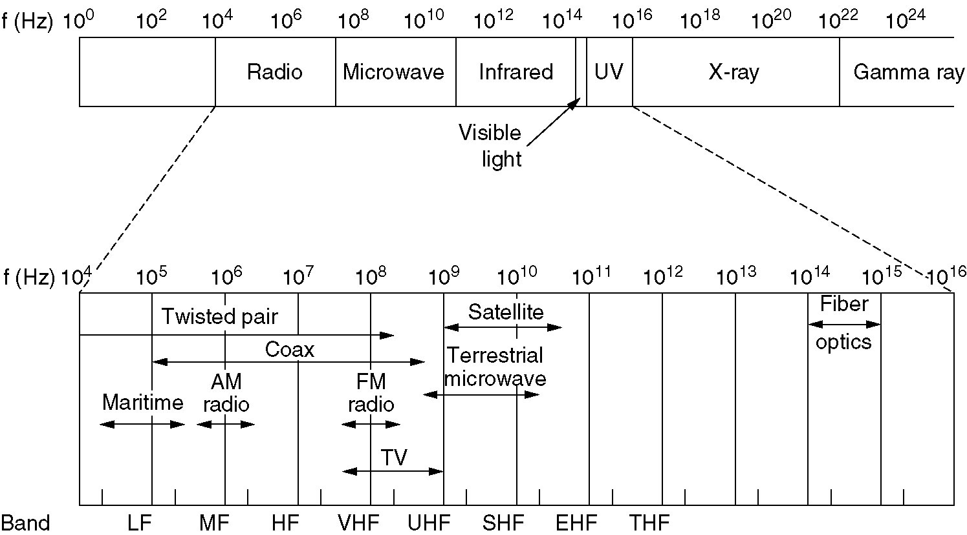
The Electromagnetic Spectrum
The electromagnetic spectrum and its uses for communication.

Slide 17
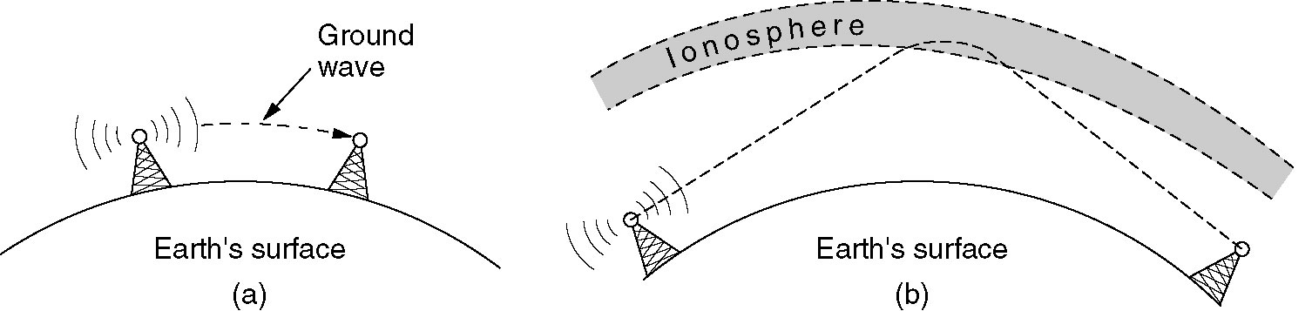
Radio Transmission
(a) In the VLF, LF, and MF bands, radio waves follow the curvature of the earth.
(b) In the HF band, they bounce off the ionosphere.

Slide 18
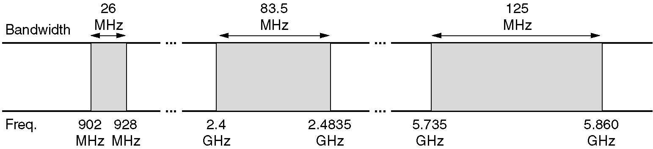
Politics of the Electromagnetic Spectrum
The ISM bands in the United States.

Slide 19
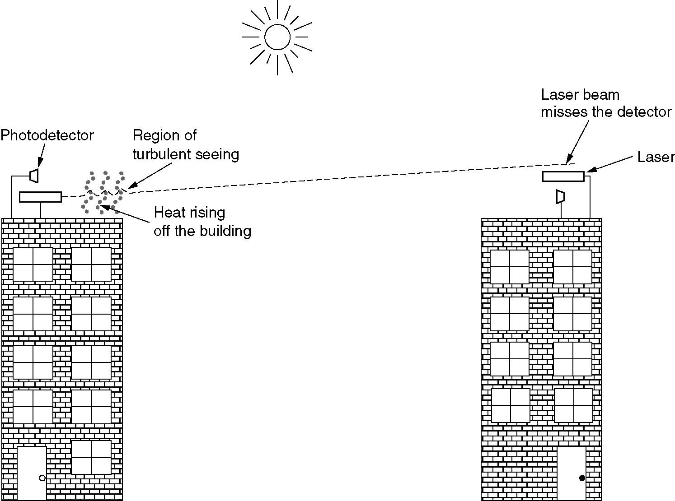
Lightwave Transmission
Convection currents can interfere with laser communication systems.
A bidirectional system with two lasers is pictured here.

Slide 20
Communication Satellites
Geostationary Satellites
Medium-Earth Orbit Satellites
Low-Earth Orbit Satellites
Satellites versus Fiber

Slide 21
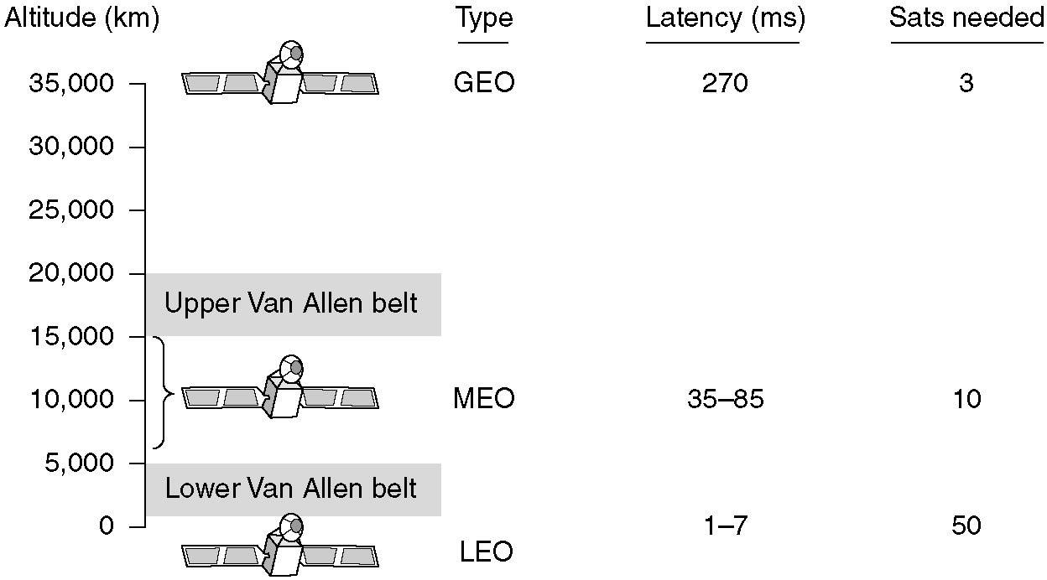
Communication Satellites
Communication satellites and some of their properties, including altitude above the earth, round-trip delay time and number of satellites needed for global coverage.

Slide 22
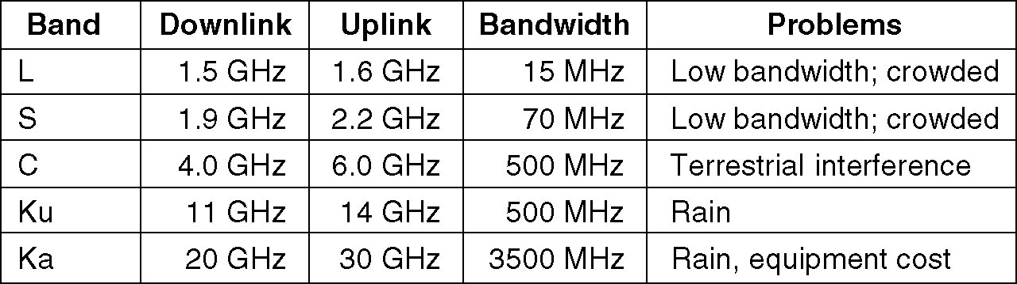
Communication Satellites (2)
The principal satellite bands.

Slide 23
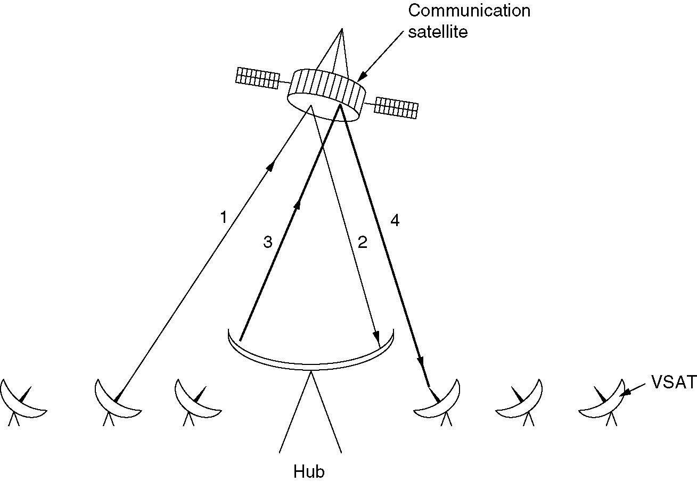
Communication Satellites (3)
VSATs using a hub.

Slide 24
Low-Earth Orbit Satellites Iridium
(a) The Iridium satellites from six necklaces around the earth.
(b) 1628 moving cells cover the earth.

Slide 25
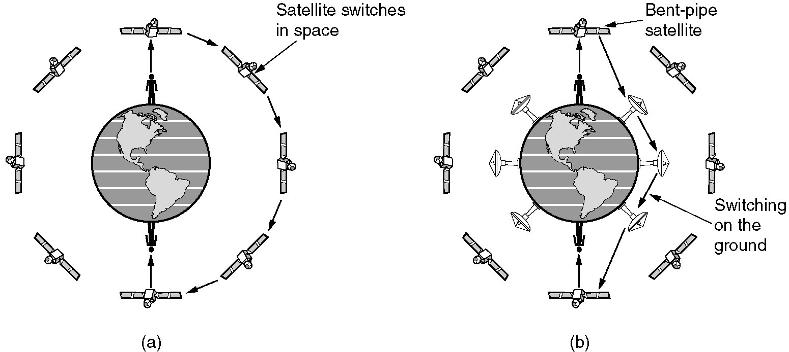
Globalstar
(a) Relaying in space.
(b) Relaying on the ground.

Slide 26
Public Switched Telephone System
Structure of the Telephone System
The Politics of Telephones
The Local Loop: Modems, ADSL and Wireless
Trunks and Multiplexing
Switching

Slide 27
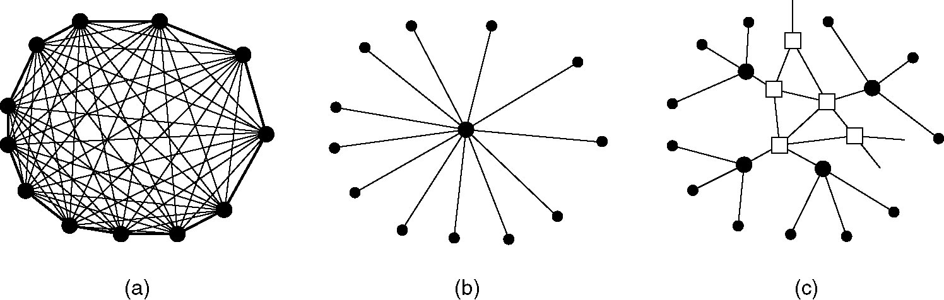
Structure of the Telephone System
(a) Fully-interconnected network.
(b) Centralized switch.
(c) Two-level hierarchy.

Slide 28
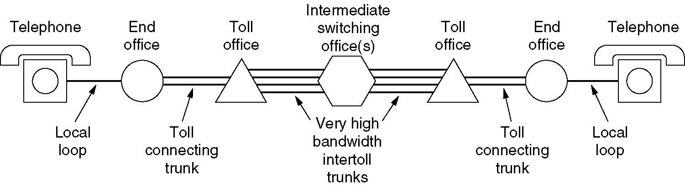
Structure of the Telephone System (2)
A typical circuit route for a medium-distance call.

Slide 29
Major Components of the Telephone System
Local loops
Analog twisted pairs going to houses and businesses
Trunks
Digital fiber optics connecting the switching offices
Switching offices
Where calls are moved from one trunk to another

Slide 30
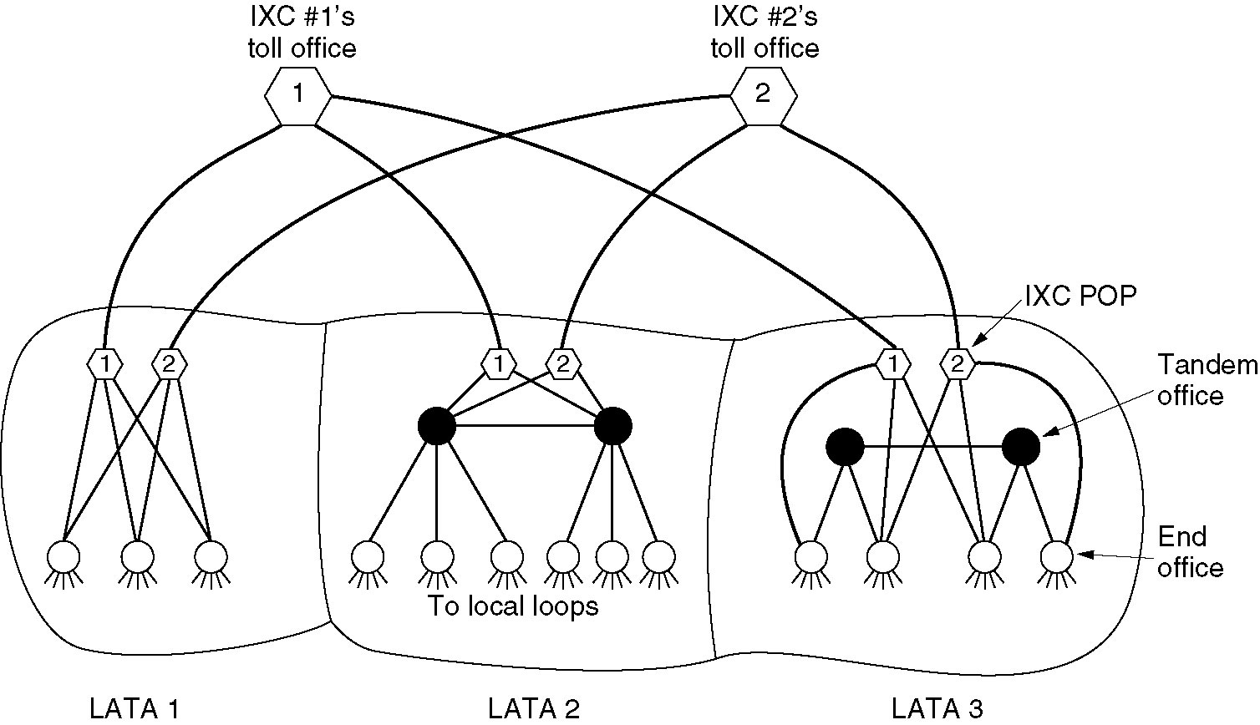
The Politics of Telephones
The relationship of LATAs, LECs, and IXCs. All the circles are LEC switching offices. Each hexagon belongs to the IXC whose number is on it.

Slide 31
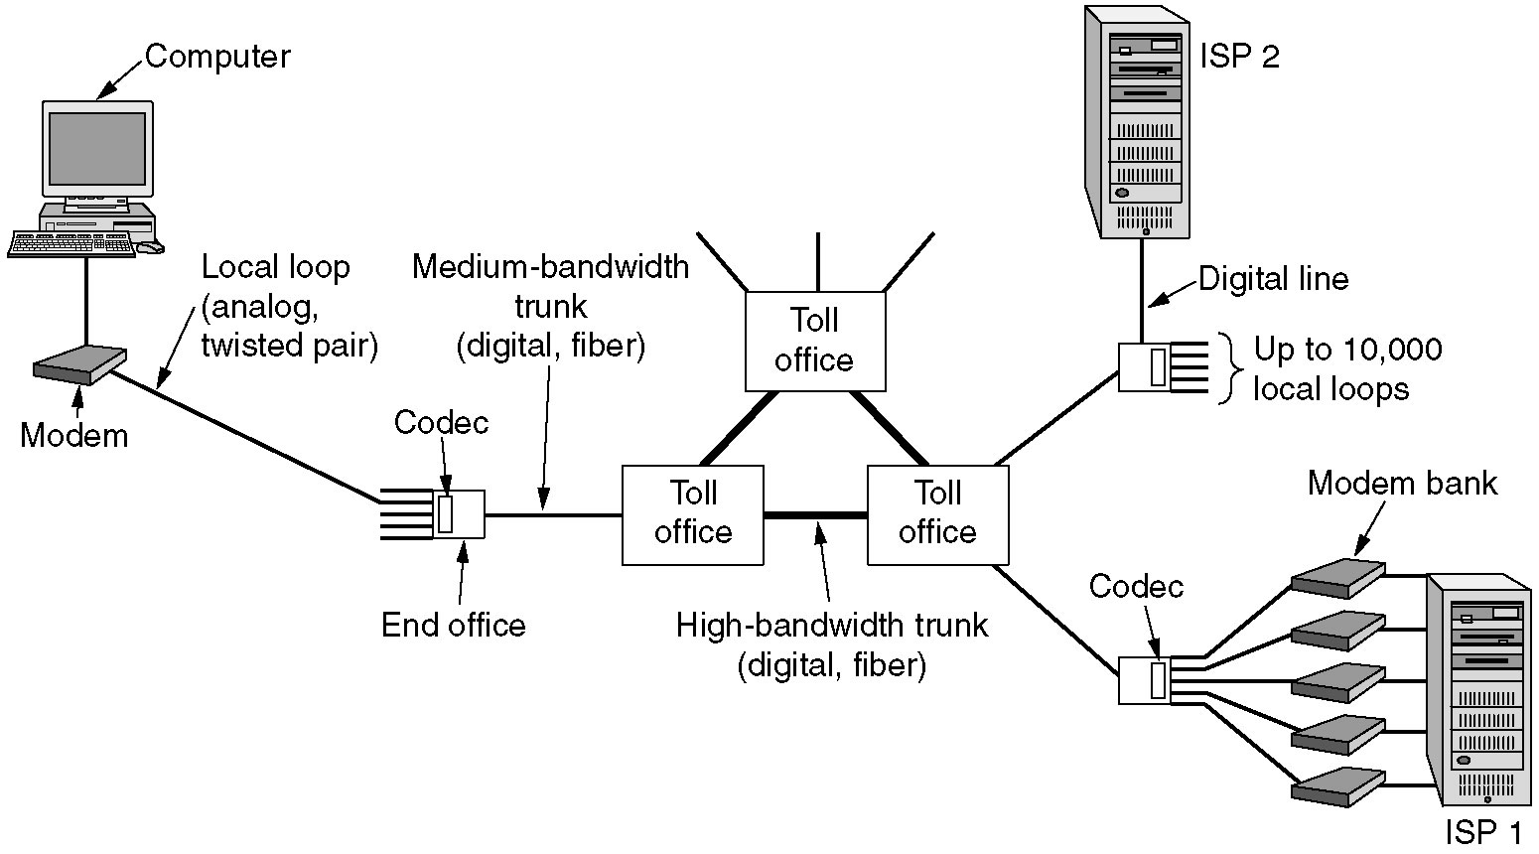
The Local Loop: Modems, ADSL, and Wireless
The use of both analog and digital transmissions for a computer to computer call. Conversion is done by the modems and codecs.

Slide 32
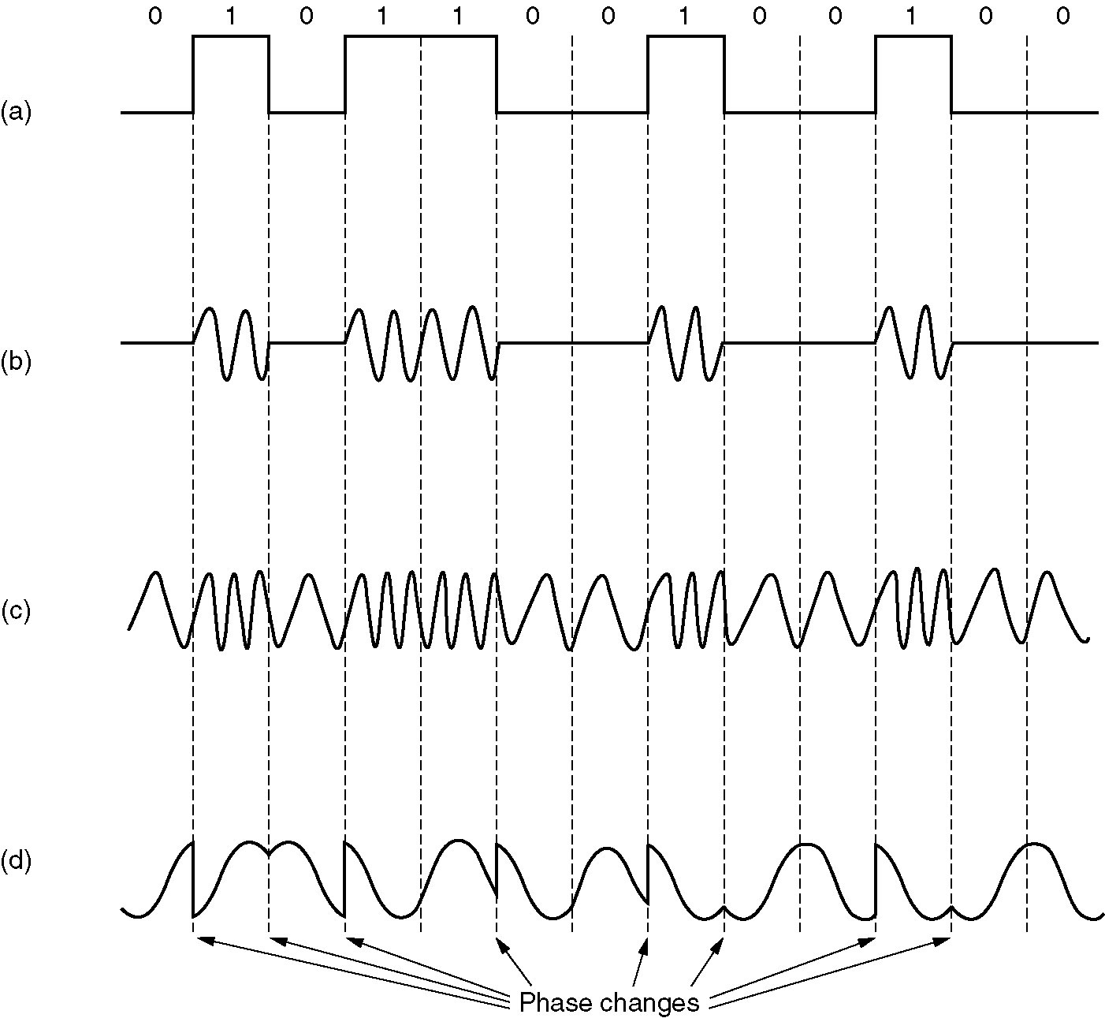
Modems
(a) A binary signal
(b) Amplitude modulation
(c) Frequency modulation
(d) Phase modulation

Slide 33
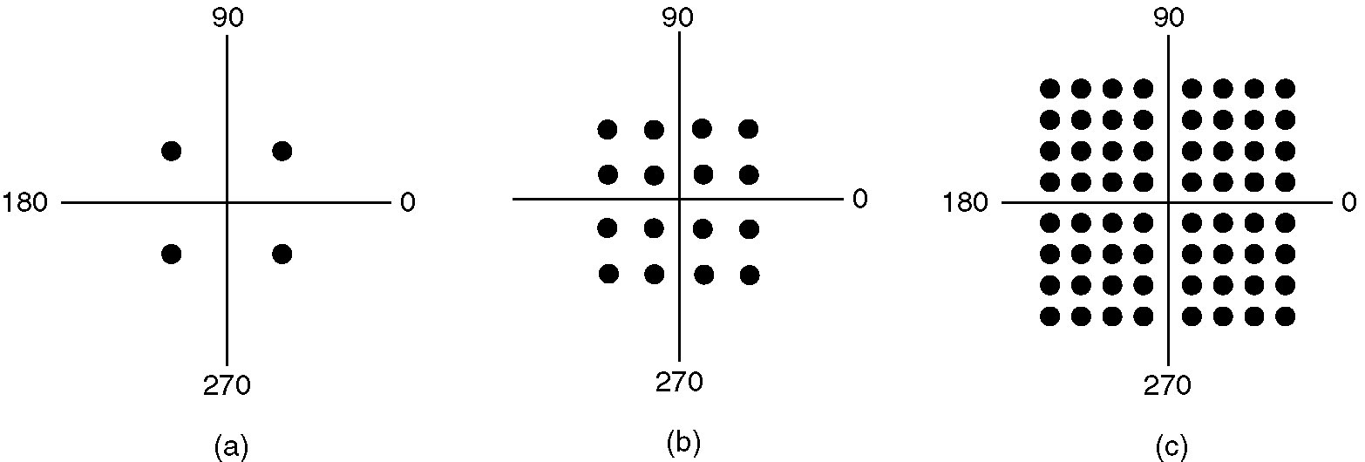
Modems (2)
(a) QPSK.
(b) QAM-16.
(c) QAM-64.

Slide 34
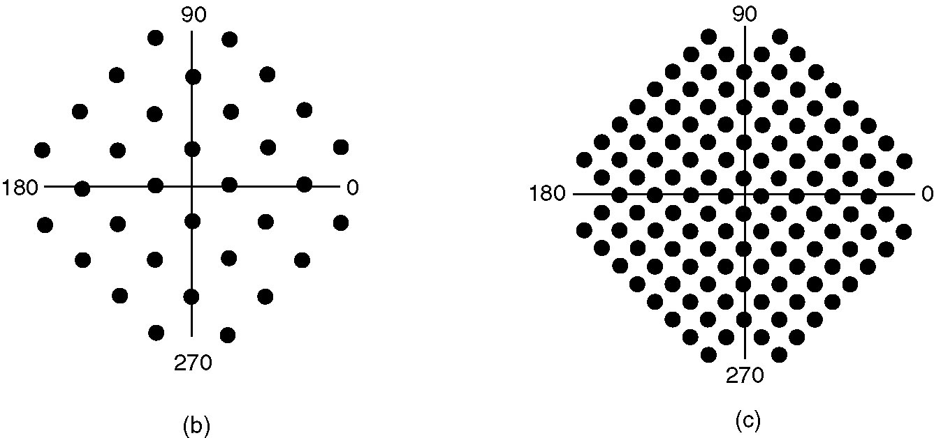
Modems (3)
(a)
(b)
(a) V.32 for 9600 bps.
(b) V32 bis for 14,400 bps.

Slide 35
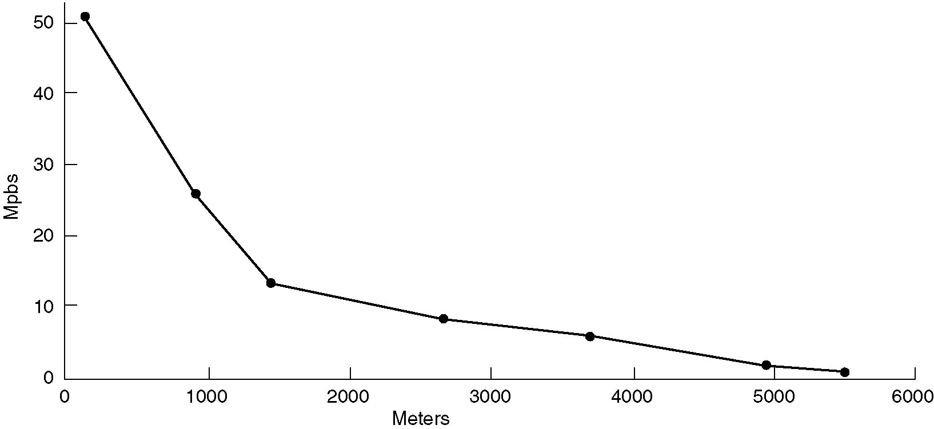
Digital Subscriber Lines
Bandwidth versus distanced over category 3 UTP for DSL.

Slide 36
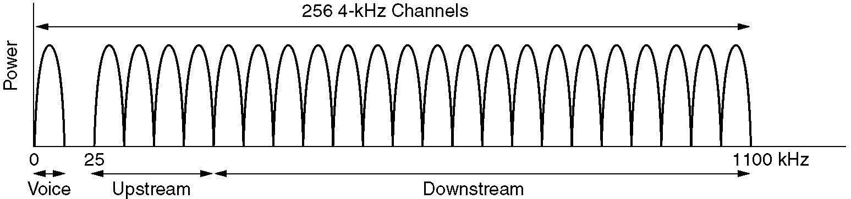
Digital Subscriber Lines (2)
Operation of ADSL using discrete multitone modulation.

Slide 37
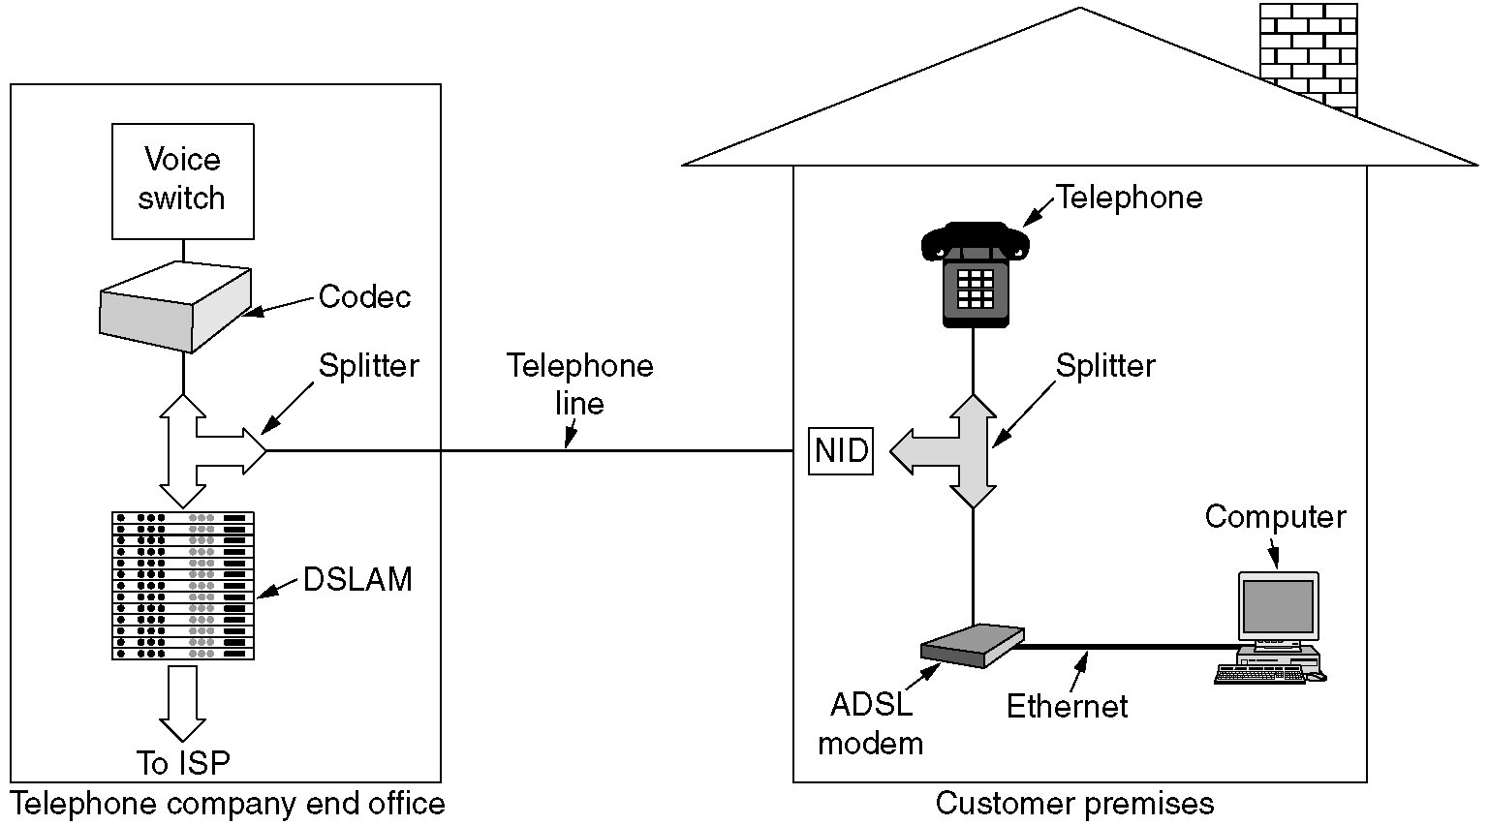
Digital Subscriber Lines (3)
A typical ADSL equipment configuration.

Slide 38
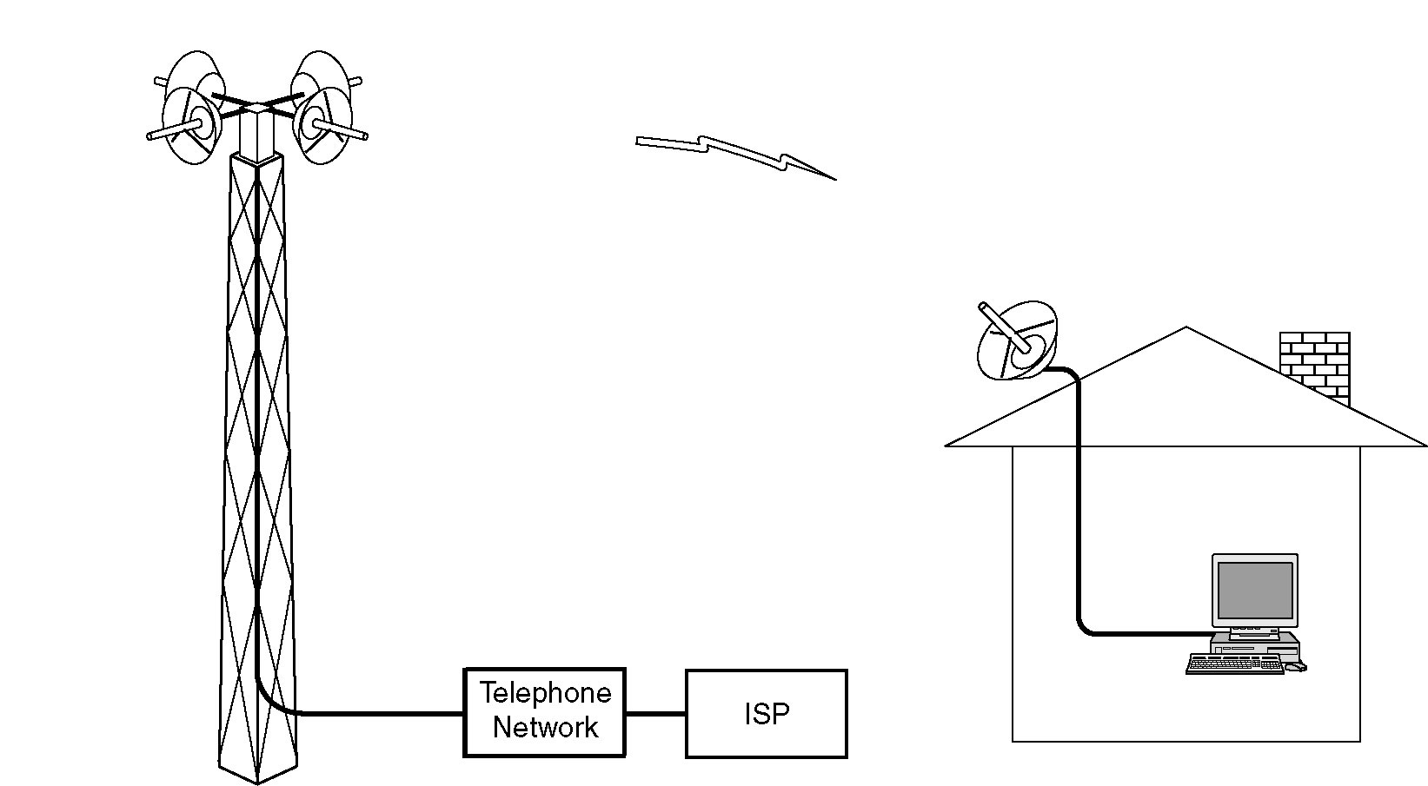
Wireless Local Loops
Architecture of an LMDS system.

Slide 39
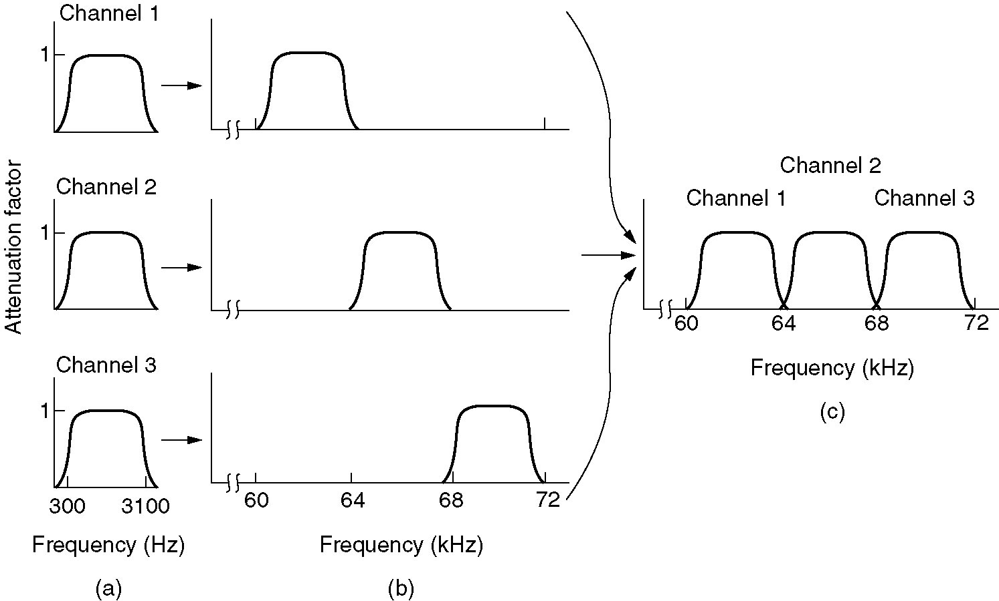
Frequency Division Multiplexing
(a) The original bandwidths.
(b) The bandwidths raised in frequency.
(b) The multiplexed channel.

Slide 40
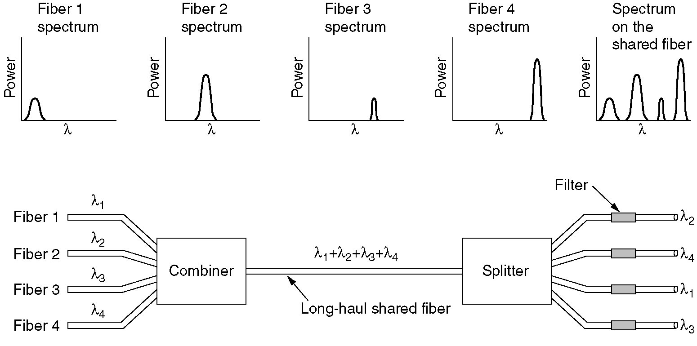
Wavelength Division Multiplexing
Wavelength division multiplexing.

Slide 41
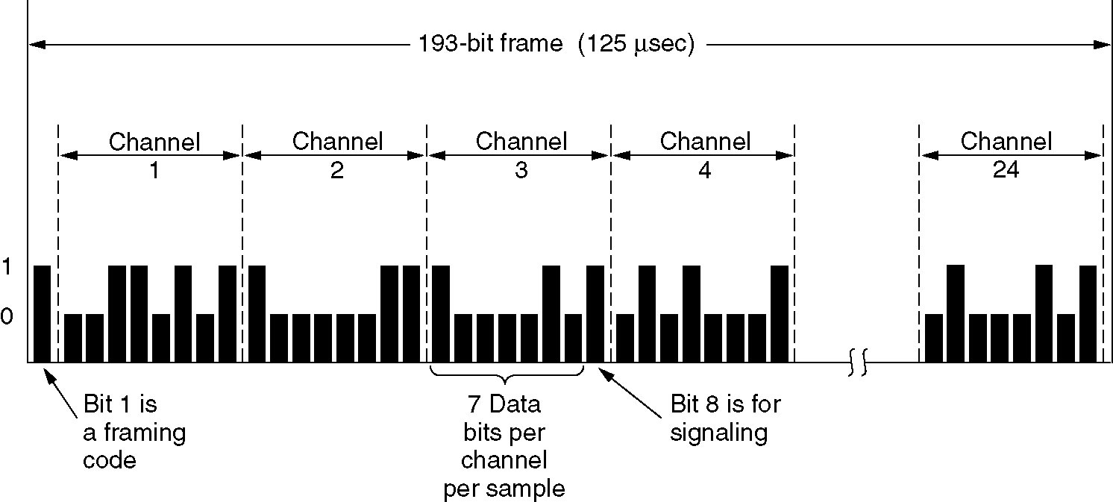
Time Division Multiplexing
The T1 carrier (1.544 Mbps).

Slide 42
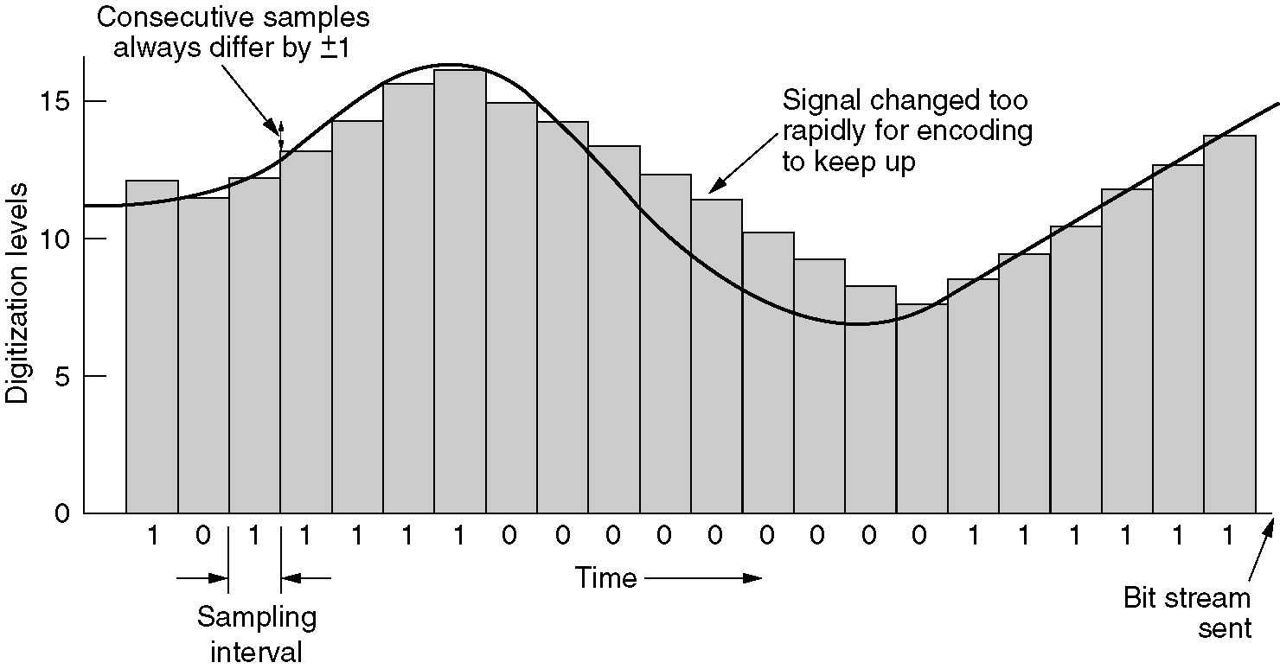
Time Division Multiplexing (2)
Delta modulation.

Slide 43
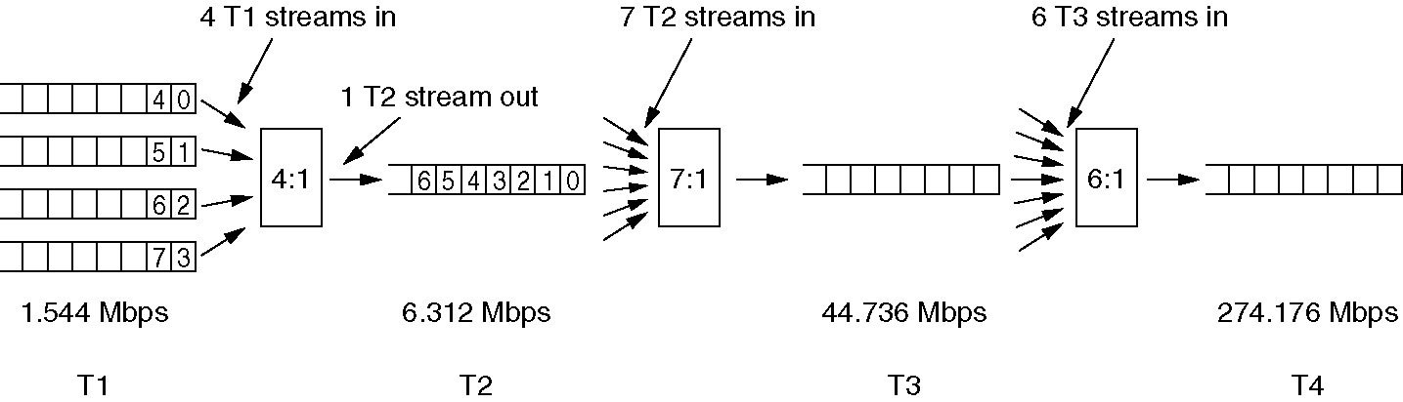
Time Division Multiplexing (3)
Multiplexing T1 streams into higher carriers.

Slide 44
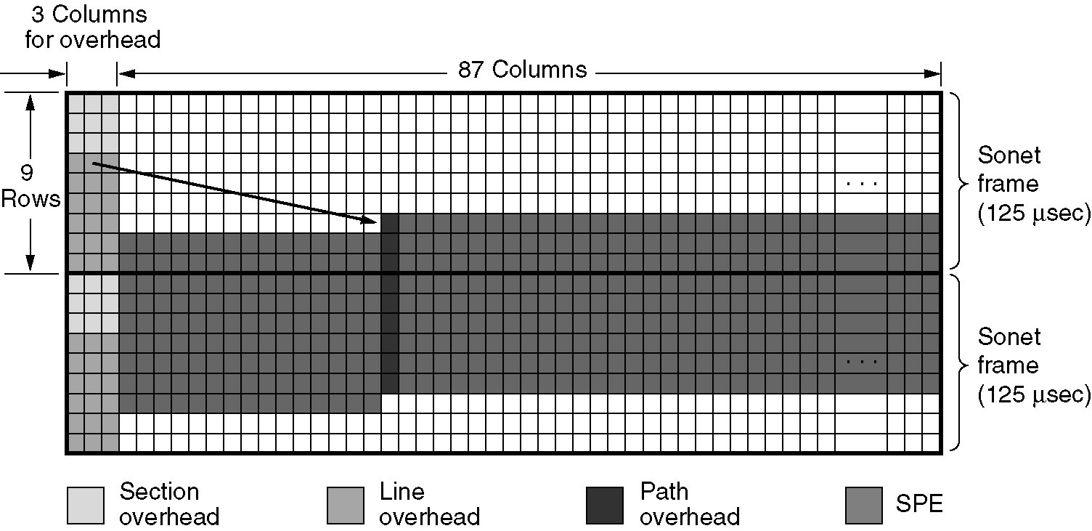
Time Division Multiplexing (4)
Two back-to-back SONET frames.

Slide 45
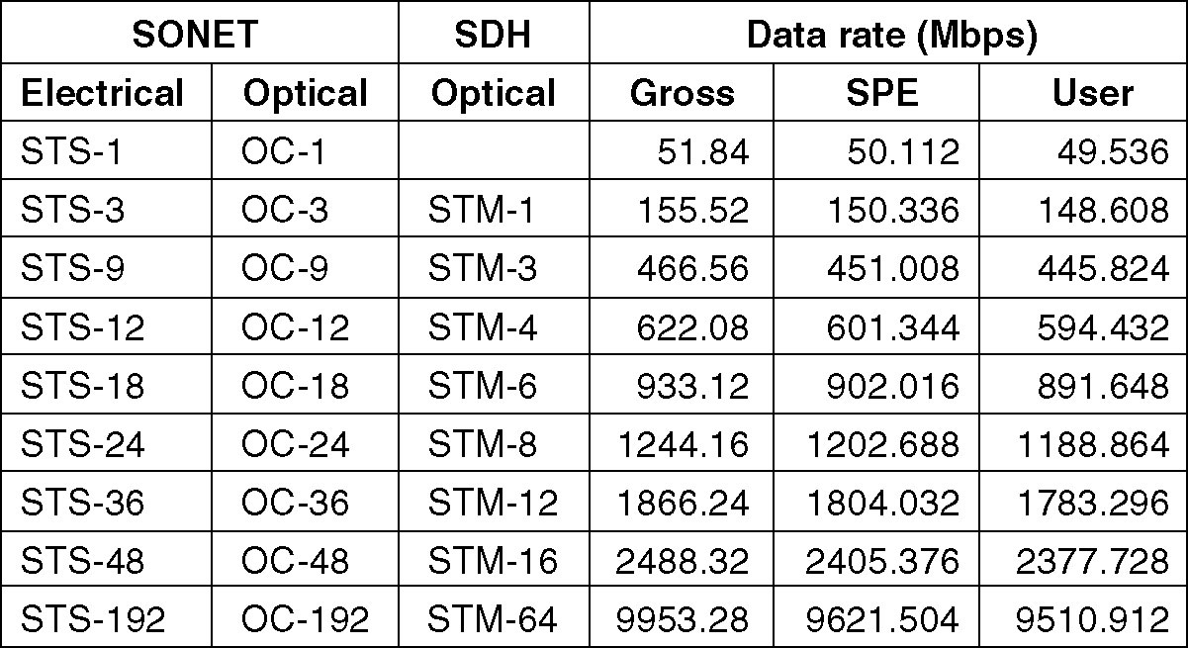
Time Division Multiplexing (5)
SONET and SDH multiplex rates.

Slide 46
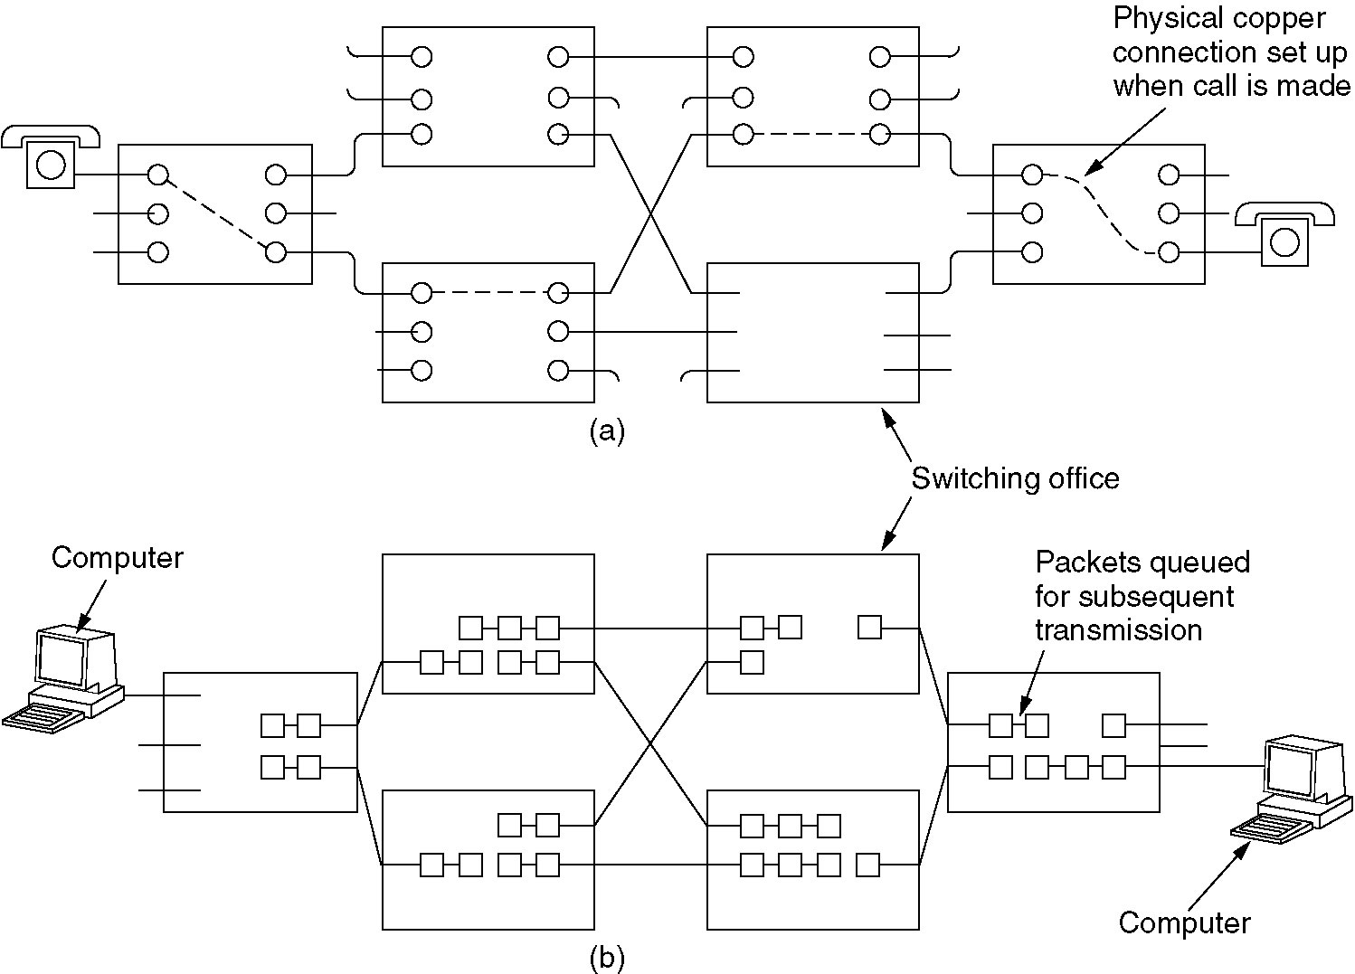
Circuit Switching
(a) Circuit switching.
(b) Packet switching.

Slide 47
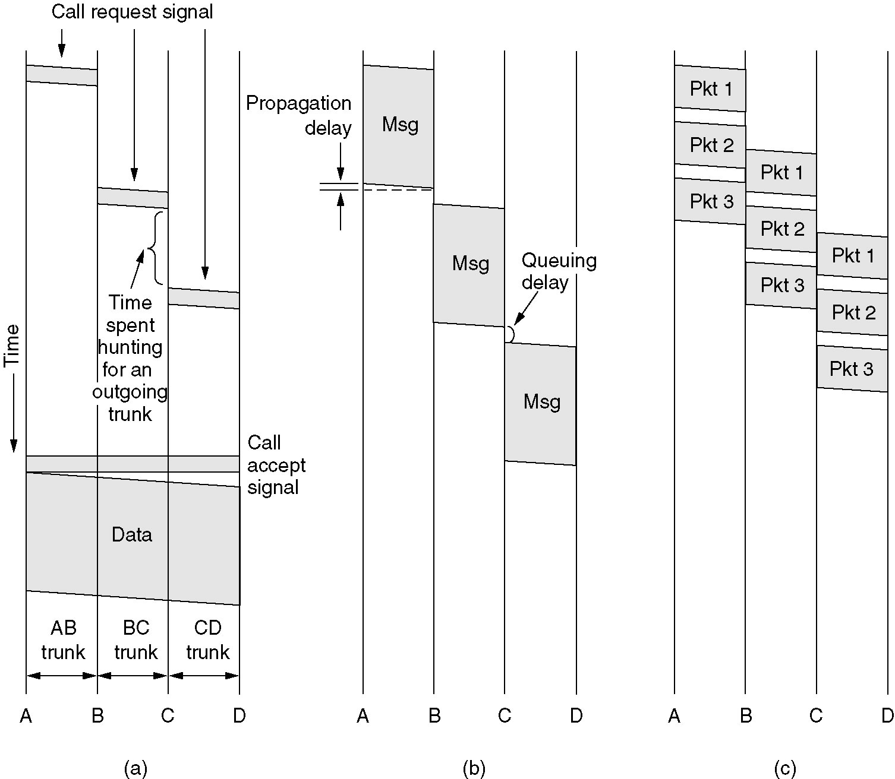
Message Switching
(a) Circuit switching (b) Message switching (c) Packet switching

Slide 48
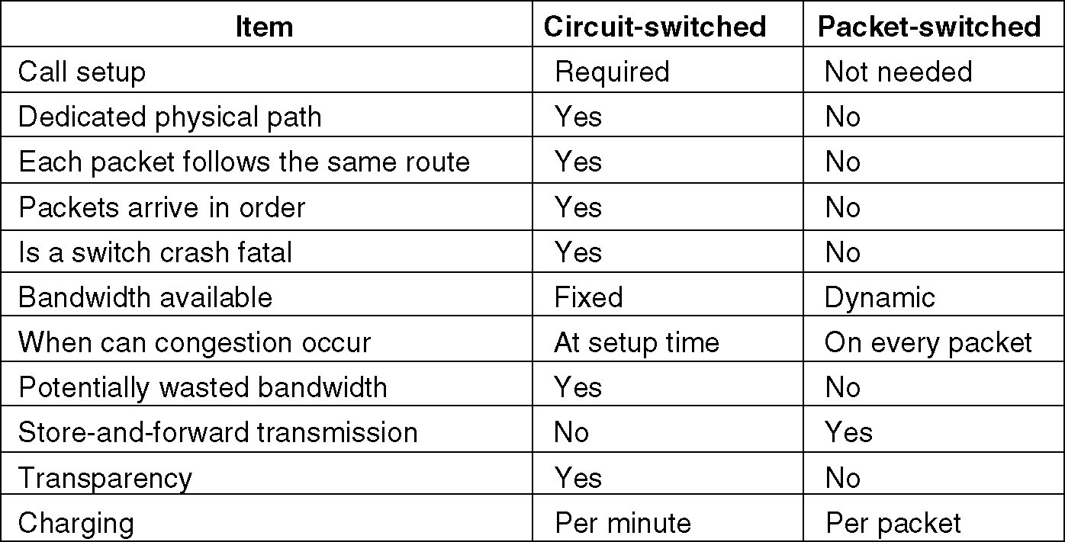
Packet Switching
A comparison of circuit switched and packet-switched networks.

Slide 49
The Mobile Telephone System
First-Generation Mobile Phones: Analog Voice
Second-Generation Mobile Phones: Digital Voice
Third-Generation Mobile Phones: Digital Voice and Data

Slide 50
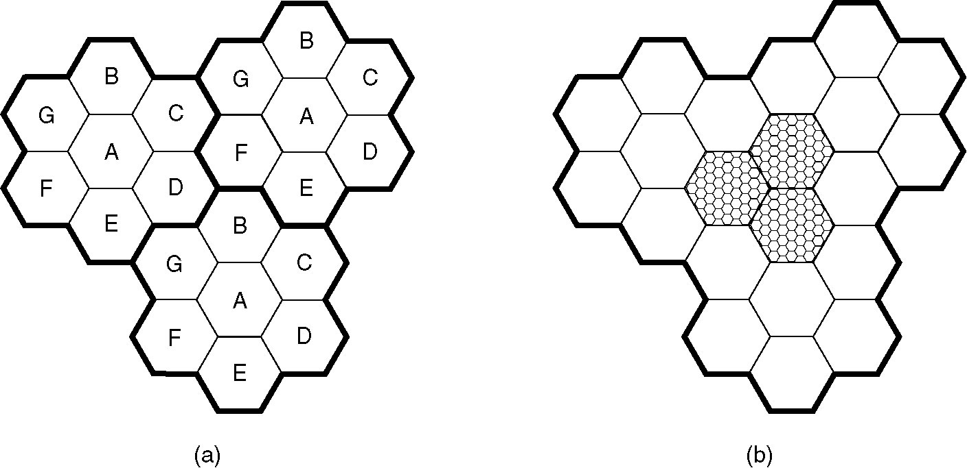
Advanced Mobile Phone System
(a) Frequencies are not reused in adjacent cells.
(b) To add more users, smaller cells can be used.

Slide 51
Channel Categories
The 832 channels are divided into four categories:
Control (base to mobile) to manage the system
Paging (base to mobile) to alert users to calls for them
Access (bidirectional) for call setup and channel assignment
Data (bidirectional) for voice, fax, or data

Slide 52
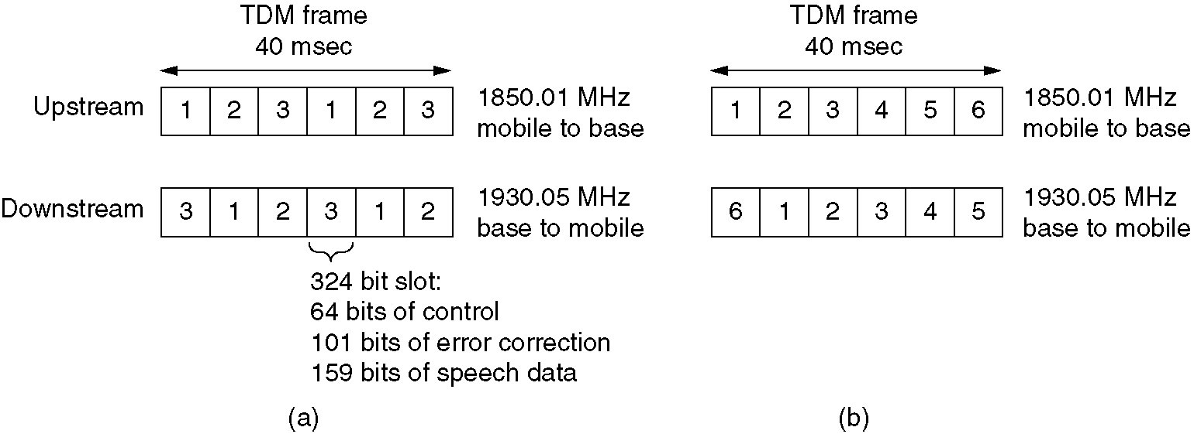
D-AMPS Digital Advanced Mobile Phone System
(a) A D-AMPS channel with three users.
(b) A D-AMPS channel with six users.

Slide 53
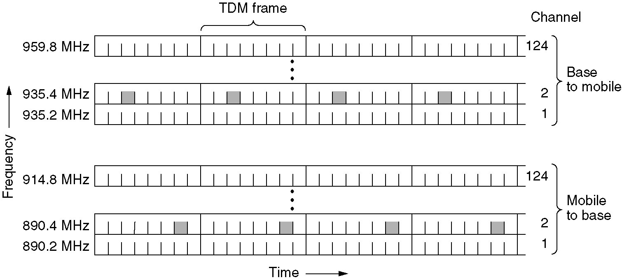
GSM Global System for Mobile Communications
GSM uses 124 frequency channels, each of which uses an eight-slot TDM system

Slide 54
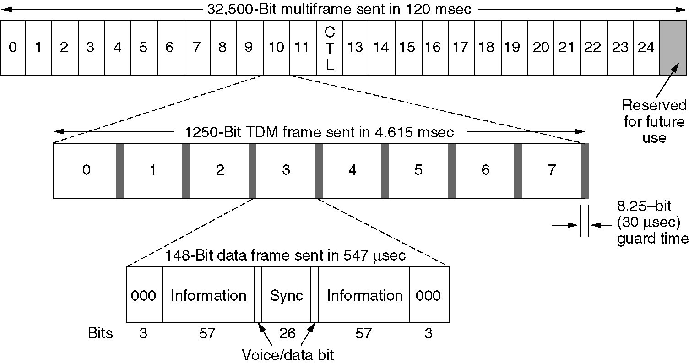
GSM (2)
A portion of the GSM framing structure.

Slide 55
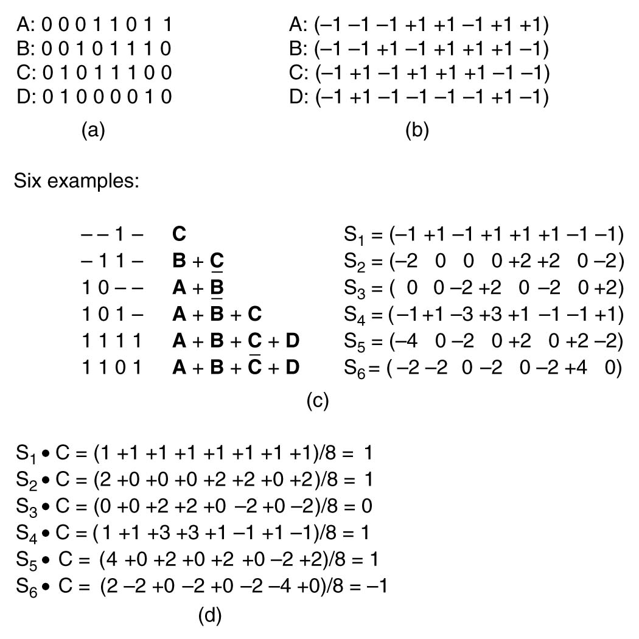
CDMA – Code Division Multiple Access
(a) Binary chip sequences for four stations
(b) Bipolar chip sequences
(c) Six examples of transmissions
(d) Recovery of station C’s signal

Slide 56
Third-Generation Mobile Phones: Digital Voice and Data
Basic services an IMT-2000 network should provide
High-quality voice transmission
Messaging (replace e-mail, fax, SMS, chat, etc.)
Multimedia (music, videos, films, TV, etc.)
Internet access (web surfing, w/multimedia.)

Slide 57
Cable Television
Community Antenna Television
Internet over Cable
Spectrum Allocation
Cable Modems
ADSL versus Cable

Slide 58
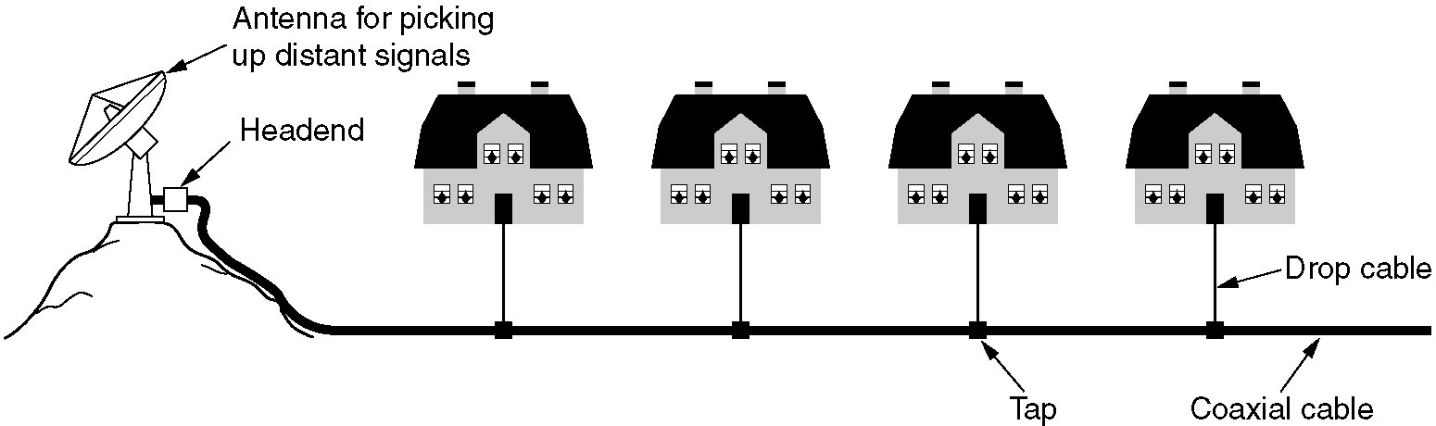
Community Antenna Television
An early cable television system.

Slide 59
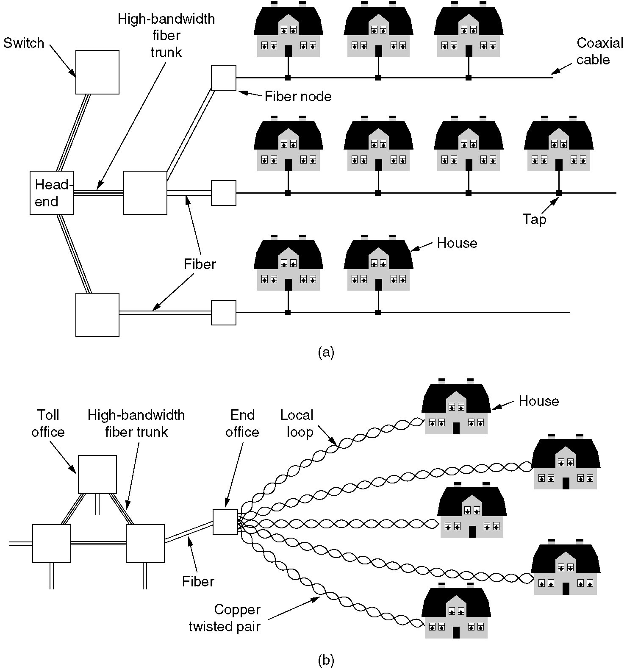
Internet over Cable
Cable television

Slide 60
Internet over Cable (2)
The fixed telephone system.

Slide 61
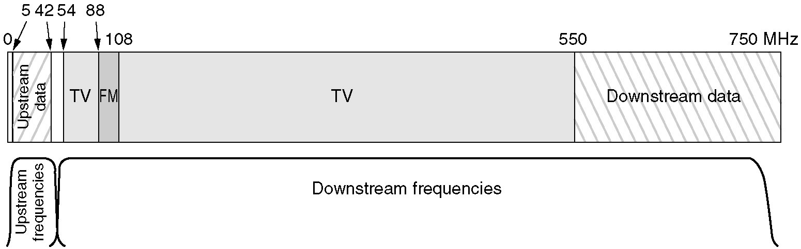
Spectrum Allocation
Frequency allocation in a typical cable TV system used for Internet access

Slide 62
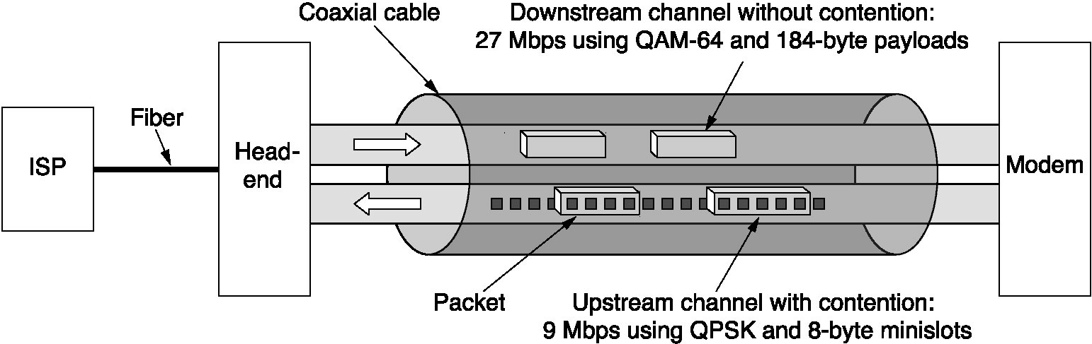
Cable Modems
Typical details of the upstream and downstream channels in North America.

